Slide 1
New Q-Learning Algorithm based on Metropolis Criterion
Aditya Gupta (agupt207@asu.edu)
Jyotishman Saikia (jsaikia@asu.edu)
Vinit Sheth (vsheth2@asu.edu)

Slide 2
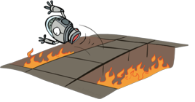
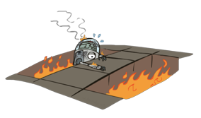
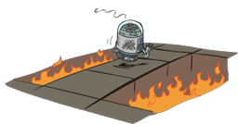
Q-Learning

Slide 3
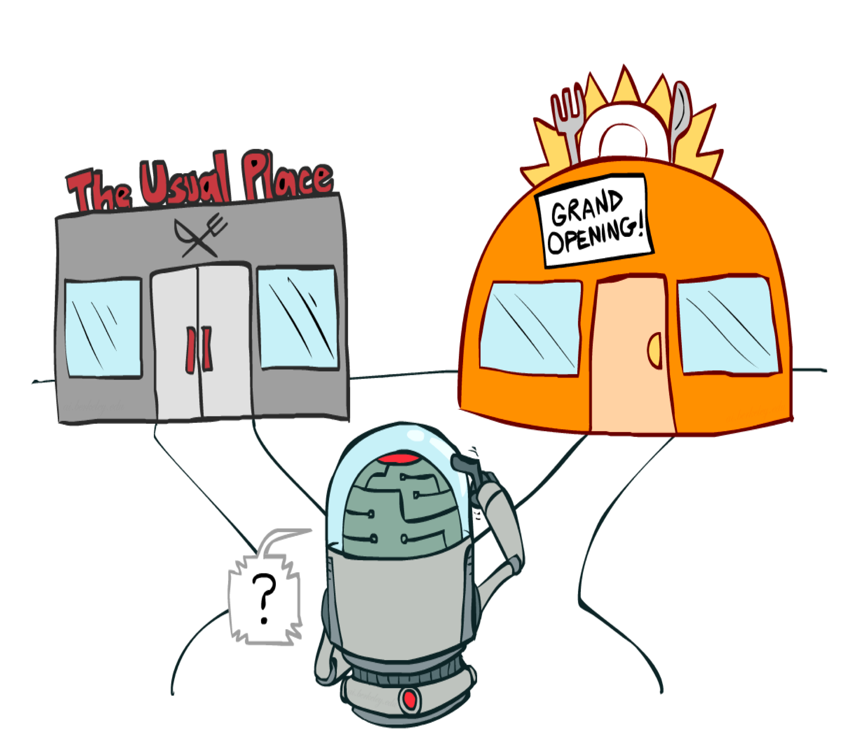
Exploration and Exploitation

Slide 4
How to explore?
Simplest Solution :- Random Actions ( 𝜺 - greedy )
Every time step, flip a coin
With (Small) probability 𝜺, act randomly
With (Large) probability 1 - 𝜺, act on current policy

Slide 5
Problems with random actions.
You do eventually explore the space, but keep thrashing around once learning is done.
One Solution :- Lower 𝜺 over time.
Another Solution :- Exploration Functions

Slide 6
Regret
Even if you learn the optimal policy, you still make mistakes along the way!
Regret is a measure of your total mistake cost: the difference between (expected) rewards, including youthful suboptimality, and optimal (expected) rewards
Minimizing regret goes beyond learning to be optimal – it requires optimally learning to be optimal
Example: random exploration and exploration functions both end up optimal, but random exploration has higher regret

Slide 7
Q-Learning based on Metropolis Criterion
Finding the proper balance between exploration and exploitation in Q-learning is one of the major issues requiring further attention.
Excessive exploration becomes unnecessary after a period of an initial interaction between the agent and the environment
As reinforcement learning is mainly used as an online learning method, excessive exploration will inevitably result in the decreasing performance of a RL algorithm.
Our benchmark paper details the task of finding the optimal policy in Q-learning transformed into a search for an optimal solution in a combinatorial optimization problem. Then the Metropolis criterion from SA (Simulated Annealing) algorithm is applied to the search procedure in order to control the balance between exploration and exploitation. Hence, in the execution process of the proposed algorithm, the exploration will gradually decay, leading to convergence towards the optimum.

Slide 8
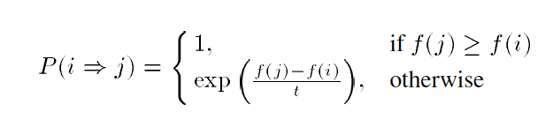
Q-Learning based on Metropolis Criterion
In the -greedy strategy, in order to balance the contradiction between exploration and exploitation, it is proposed to explore nonoptimal actions in the current situation with a fixed probability.
However, the longer the learning process, the more accurate the knowledge of the agent becomes (i.e., the Q values converge to the optimal Q, and hence continuing exploration with fixed probability must result in the decrease of performance of the system.
Therefore, it is necessary to decay the exploration appropriately after some adequate amount of interactions between the agent and the environment.
Toward this effect, the Metropolis criterion from SA algorithm is introduced into the action-selection strategy of Q-learning. The resulting algorithm, called SA-Q-learning, is presented

Slide 9
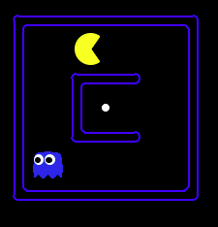
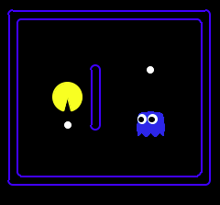
Experiment Setup
Attribute | SmallGrid | BigGrid
State Space | 2500 | 28224
State Action Pairs | 10000 | 1,12,896
Step Cost | -1 | -1
Final Reward | 550 | 550

Slide 10
Results for Benchmark Algorithm
E - greedy Q Learning and Q-Learning based on metropolis Criterion are implemented on Small Grid and Big grid.
They are trained for 2000 Episodes (1 Episode is 1 Game of Pacman)
After training it is tested by playing 10 games of pacman
In both the cases for small grid pacman wins 10/10 games.
For Big Grid for both the cases pacman loses 10/10 games.
The average score after every 100 episodes are recorded.
The total number of random choices and total number of choices based on learned policy are also recorded after every 100 episodes.

Slide 11
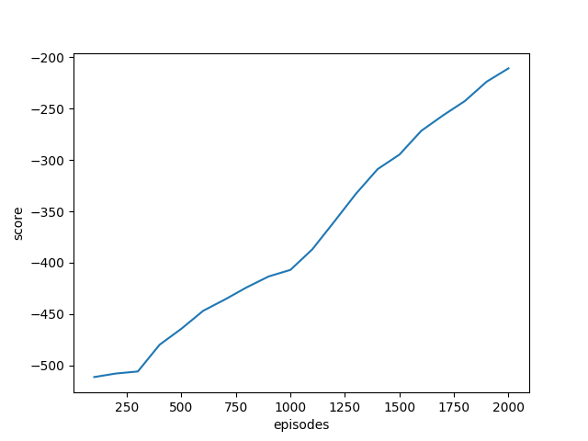
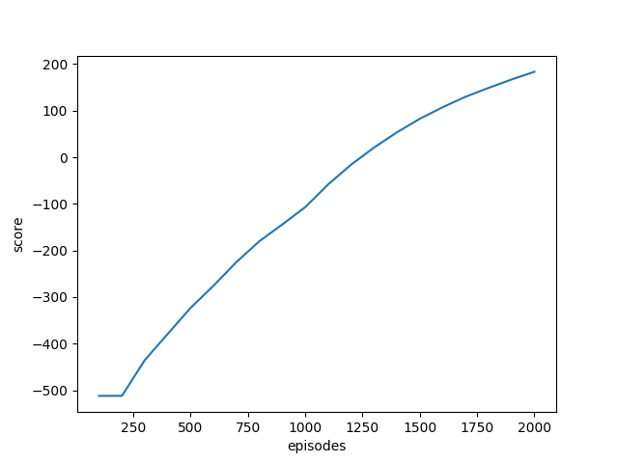
For Small Grid
E-greedy
Metropolis

Slide 12
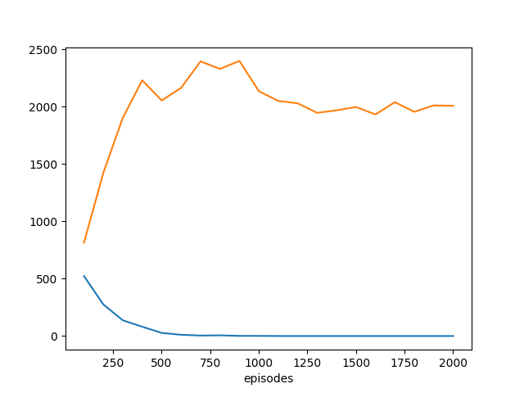
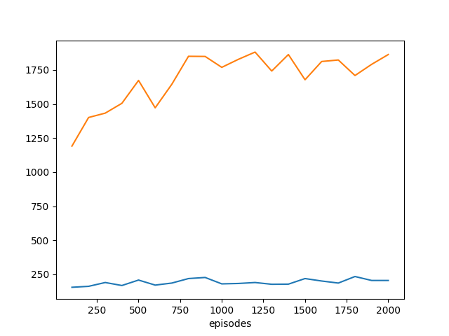
For Small Grid
E-greedy
Metropolis

Slide 13
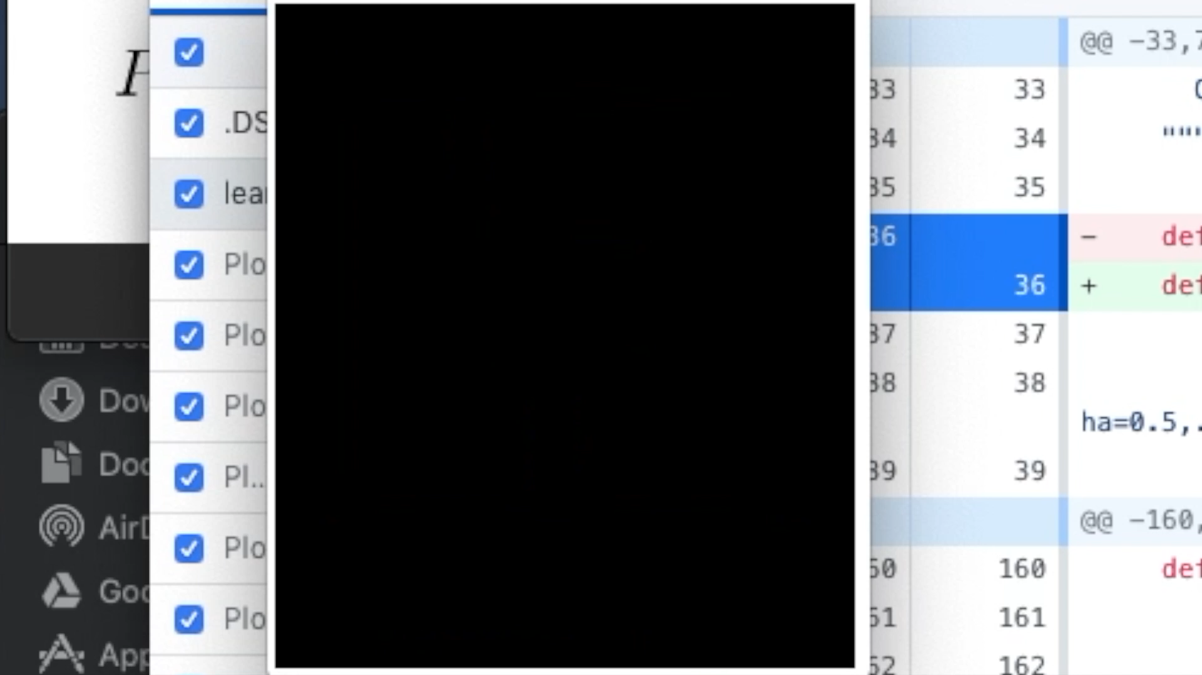

Slide 14
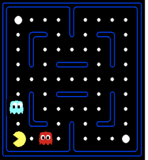
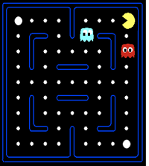
Challenges
Q-Learning does not perform well for state space environments where there are many similar states like in pacman domain.
Basic Q-Learning keeps a table of all q-values. In realistic situations, we cannot possibly learn about every single state! Too many states to visit them all in training

Slide 15
Extension
Instead, we want to generalize: Learn about some small number of training states from experience Generalize that experience to new, similar situations
Solution: describe a state using a vector of features (properties) Features are functions from states to real numbers (often 0/1) that capture important properties of the state
Using a feature representation, we can write a Q function for any state using a few weights
Advantage: our experience is summed up in a few powerful numbers
As an improvement to this algorithm, we tried using feature-based approach for Q-Learning with Metropolis Criterion.
We used the following features - - how far away the next food is - how far away the ghost is

Slide 16

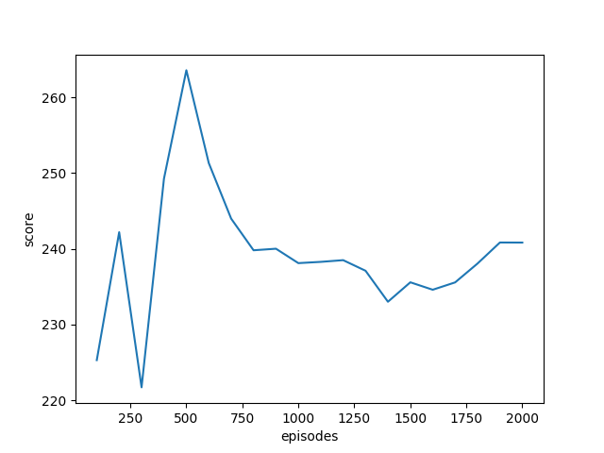
Small Grid
Feature Based
E greedy
E greedy
Feature Based Metropolis
MetroPolis

Slide 17
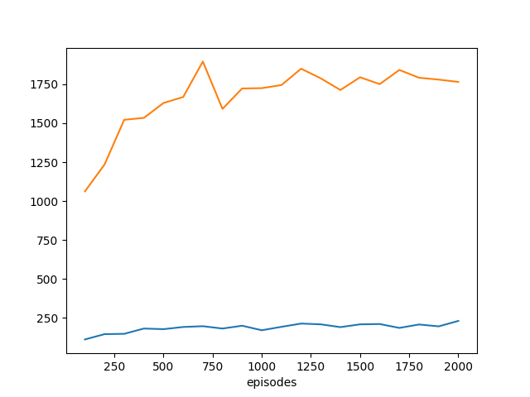
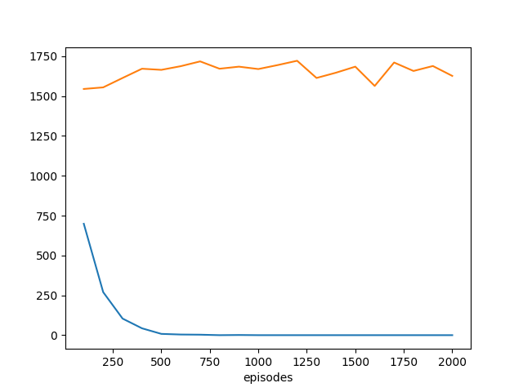
Small Grid
Feature Based
E greedy
E greedy
Feature Based Metropolis
MetroPolis

Slide 18
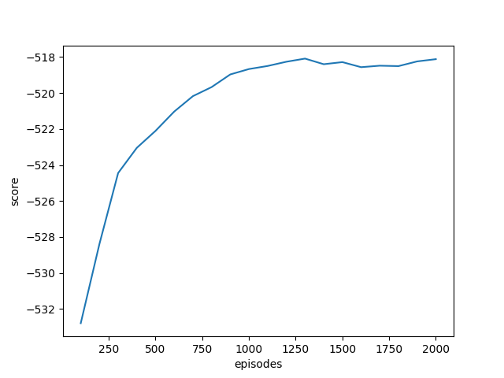
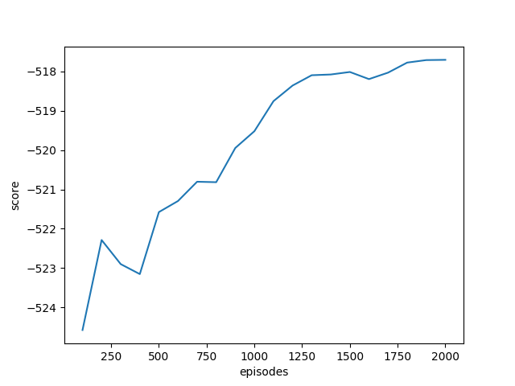
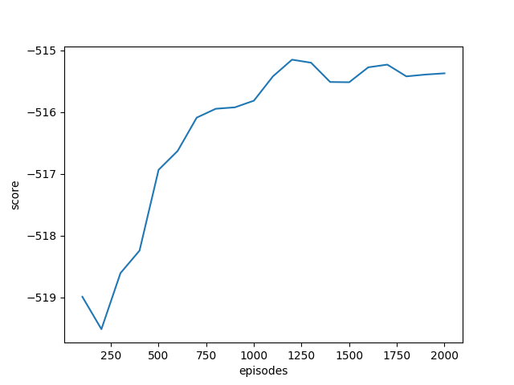
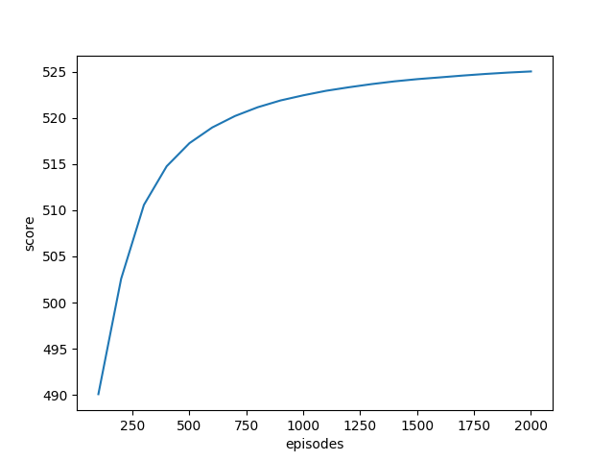
Big Grid
Feature Based
E greedy
E greedy
Feature Based Metropolis
MetroPolis

Slide 19


Slide 20
THANK YOU !

